Slide 1
Building and Training Your 2D CNN Model with OpendTect
Webinar – 15 June 2023
Hadyan Pratama & David Markus, dGB Earth Sciences

Slide 2
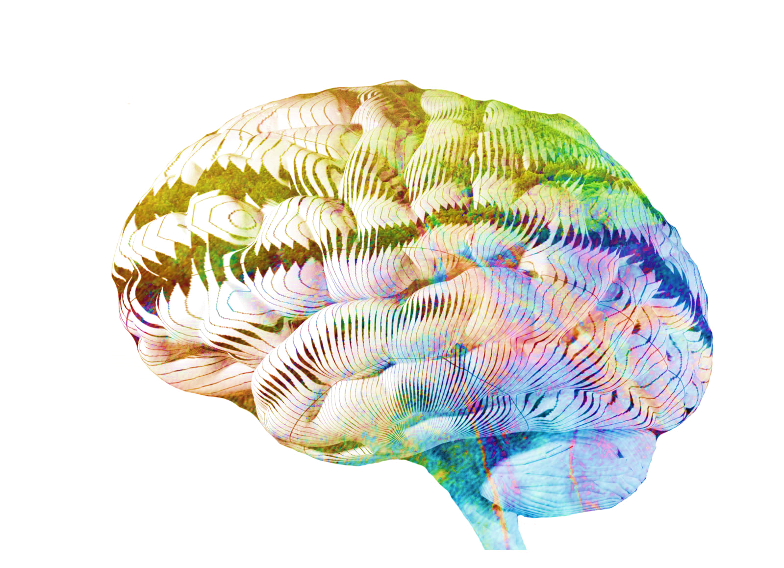
Outline
Seismic Fault Segmentation
2D U-Net Transfer Learning
Live Demo

Slide 3
Outline
Seismic Fault Segmentation
2D U-Net Transfer Learning
Live Demo

Slide 4
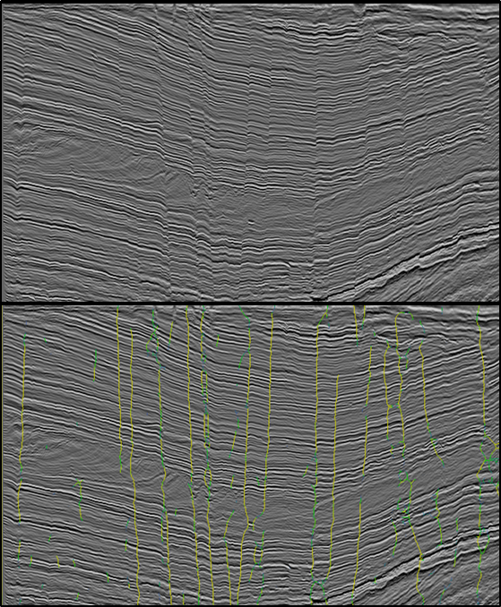
Seismic Fault
Faults are pivotal geological features in reservoir characterization as they can trap hydrocarbons, forming reservoirs.
Manual interpretation of seismic images by domain experts can be time-consuming, taking months to complete.
Artificial Intelligence technology, specifically Convolutional Neural Network (CNN) methods, offers a solution to expedite seismic interpretation while improving accuracy.
AI-driven seismic interpretation accelerates the process and enhances the precision of identifying faults, saving time and resources.
By leveraging AI technology, experts can focus on higher-level analysis, utilizing their expertise for more comprehensive reservoir evaluation.

Slide 5
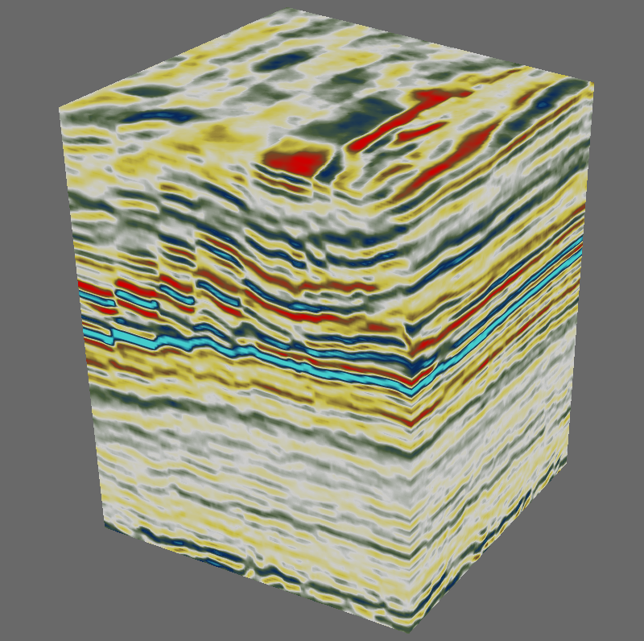
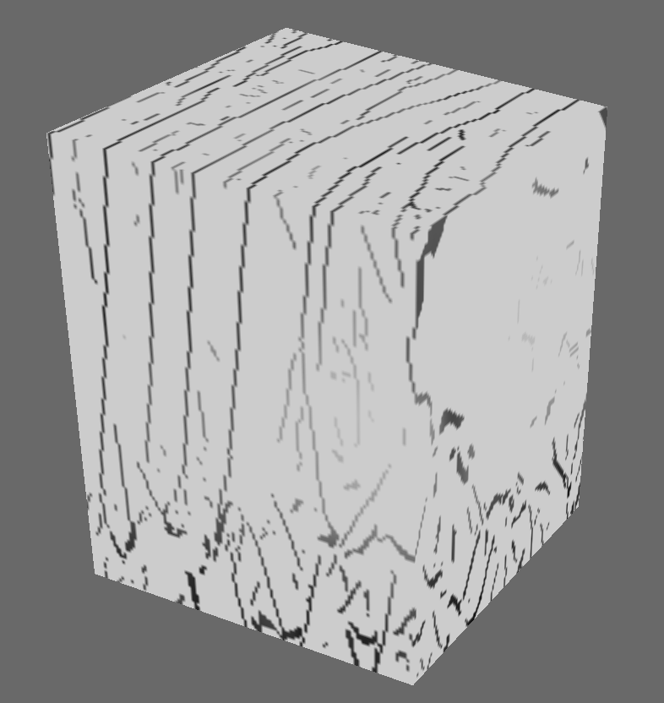
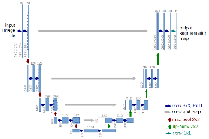
Existing 3D Fault Predictor
Faults
Input seismic
3D Unet
Machine Learning
predicted faults
Input 128x128x128
Output 128x128x128

Slide 6
Outline
Seismic Fault Segmentation
2D U-Net Transfer Learning
Live Demo

Slide 7
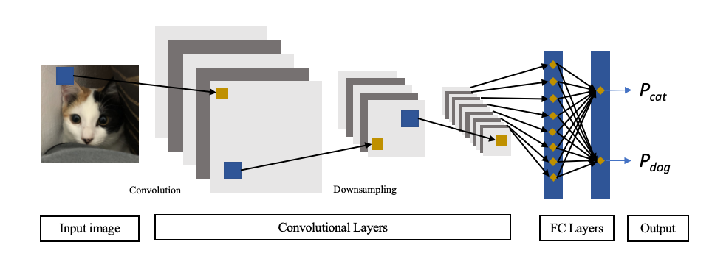
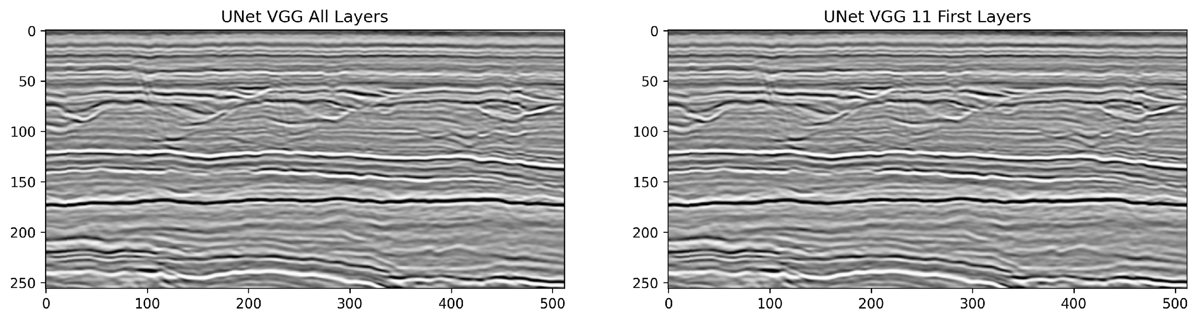
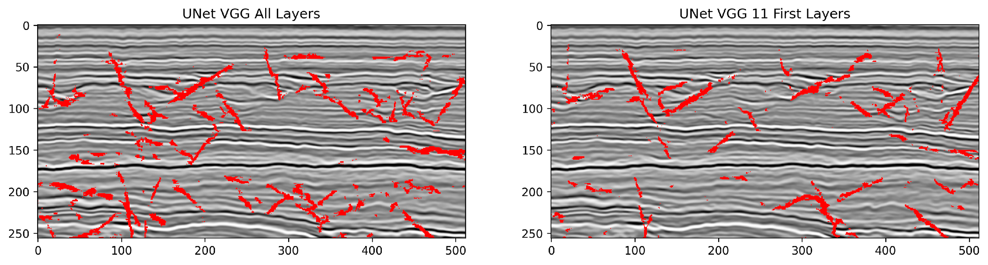
Image Segmentation
Image Classification
Assign single label
Image segmentation and image classification are two distinct tasks within Convolutional Neural Network (CNN) algorithms, each serving different purposes in computer vision.
Image classification aims to assign a single label or class to an entire input image, categorizing it into predefined classes or categories.
On the other hand, image segmentation provides a more fine-grained analysis of an image, allowing for pixel-level identification and differentiation of various objects, boundaries, or areas of interest.
For seismic fault identification, the problem falls under image segmentation, as the objective is to assign each point in the seismic data to a specific predefined class.
Image Segmentation
Mapping each pixel points

Slide 8
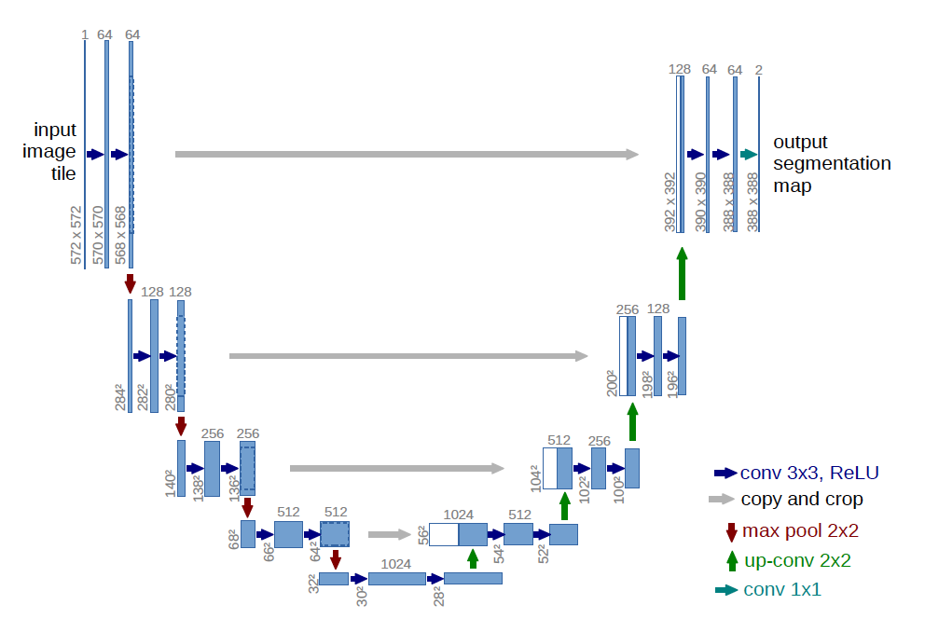
2D U-Net Architecture
U-Net is a popular and effective architecture for image segmentation tasks due to its ability to capture both local and global contextual information.
The unique "U" shape of the U-Net architecture allows for the efficient integration of low-level and high-level features, enabling precise localization and segmentation of objects within an image.
U-Net incorporates a contracting path and an expanding path, which enables the model to capture detailed features in the contracting path and use them for accurate segmentation in the expanding path.
U-Net Architecture (Ronneberger et al., 2015)
Contracting
Expanding

Slide 9
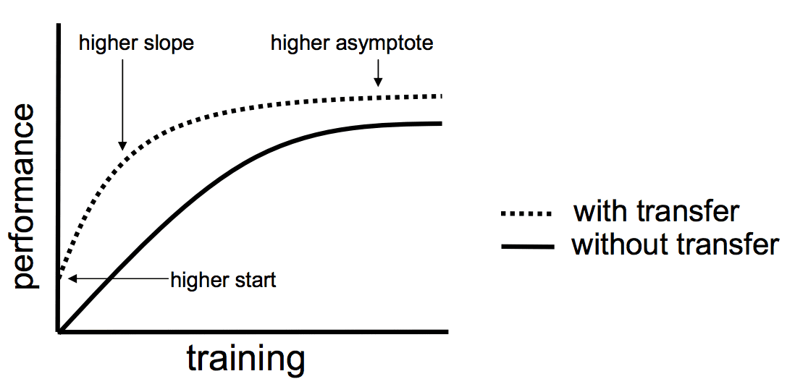
Transfer Learning
Transferred the previous learnt weights to a new problem.
Transferred the weights and architecture from a pre-trained model that had been trained using a large image dataset e.g., ImageNet.
A previous study found that transferring features/weights even from distant tasks yields better performance than using random features.
Example of pre-trained models: VGG19, ResNet50, Inception, Mobilenet, etc.
S. J. Pan and Q. Yang, "A Survey on Transfer Learning," in IEEE Transactions on Knowledge and Data Engineering, vol. 22, no. 10, pp. 1345-1359, Oct. 2010, doi: 10.1109/TKDE.2009.191.

Slide 10
Outline
Seismic Fault Segmentation
2D U-Net Transfer Learning
Live Demo

Slide 11
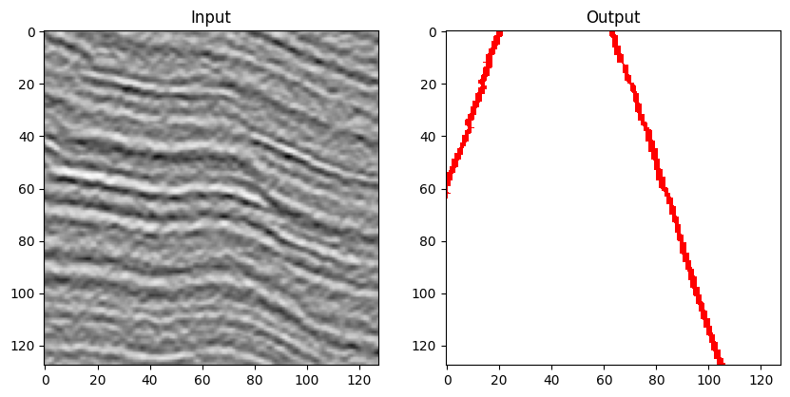
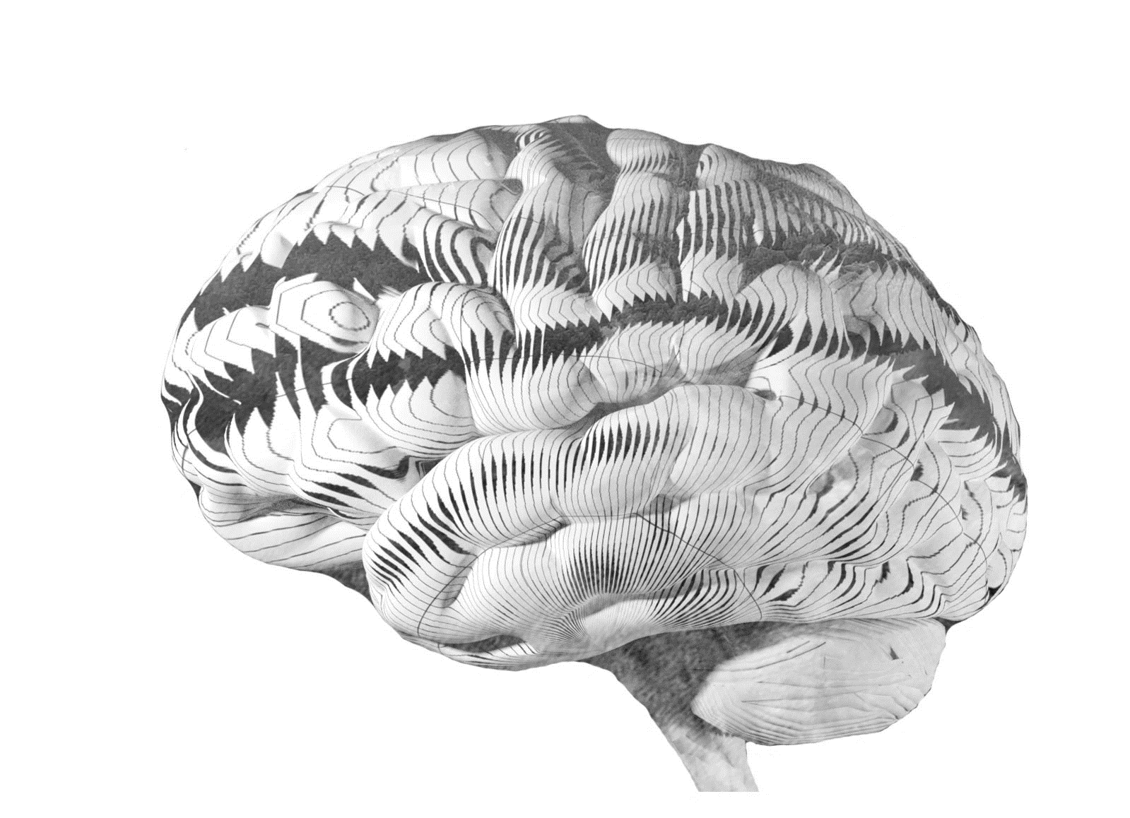
Live Demo Session
Training the 2D U-Net VGG19 model in Jupyter Notebook
Save the model with the correct header
Import the saved model to OpendTect
Apply the imported model to real seismic data in OpendTect
Display the applied result
Bonus session:
extract seismic data for training your own model
use OpendTect’s python library dgbpy to train your own model
Synthetic data from FaultSeg3D: Link (github.com)
2D U-Net VGG19 Model
Wu, Xinming & Liang, Luming & Shi, Yunzhi & Fomel, Sergey. (2019). FaultSeg3D: Using synthetic data sets to train an end-to-end convolutional neural network for 3D seismic fault segmentation. Geophysics. 84. IM35–IM45. 10.1190/geo2018-0646.1.

Slide 12
Concluding Remarks
We have shown it is easy to use the OpendTect Machine Learning Plugin Python development environment to:
create new model architectures
customizing models
transfer-train weights from previous models
import models back to OpendTect
In the next webinar we will
use data augmentation to facilitate better training outcomes
apply these models in an interpretive workflow
fine-tune the models using transfer-training

Slide 13
Thank you for watching
For more information visit dgbes.com or email info@dgbes.com

